Slide 1
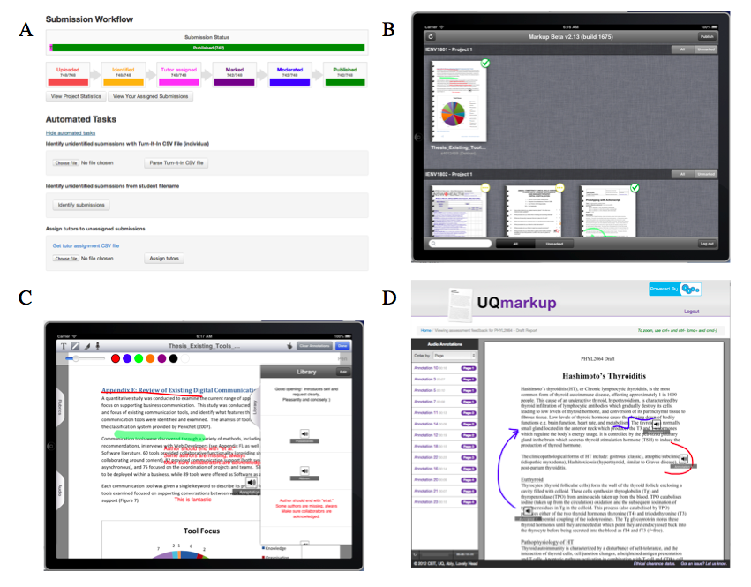
XX
XX
XXXXX
Notes:
Figure 1. A) Administration Interface B) iPad library of submissions available for marking or uploading; C) iPad feedback view, with examples of each type of annotation embedded; D) Feedback viewer showing annotated document.

Slide 2
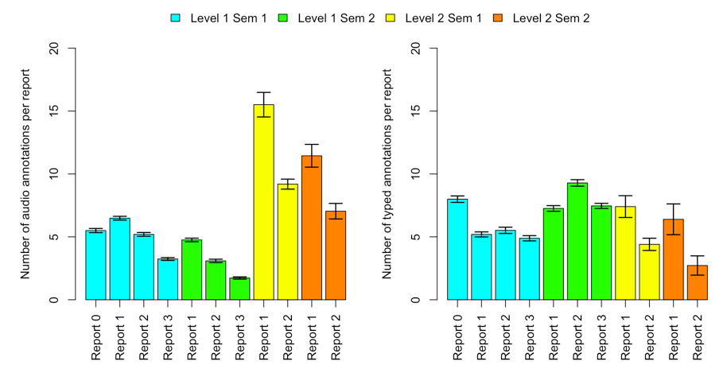
A
*
B
*
Notes:
Figure 2: Number of audio and typed annotations for level 1 course (Report 0: n=681, Report 1: n=1559, Report 2: n=1535, Report 3: n=1516 and for the level 2 course (Report 1: n=299, Report 2: n=295). Shown is the A) Mean+/-SEM number of audio annotations per report across two semesters of level 1 and 2 subjects; B) Mean+/-SEM number of typed annotations per report across two semesters of level 1 and 2 subjects. * indicates a significant difference in the number of annotations between first and second year reports (p<0.05).

Slide 3
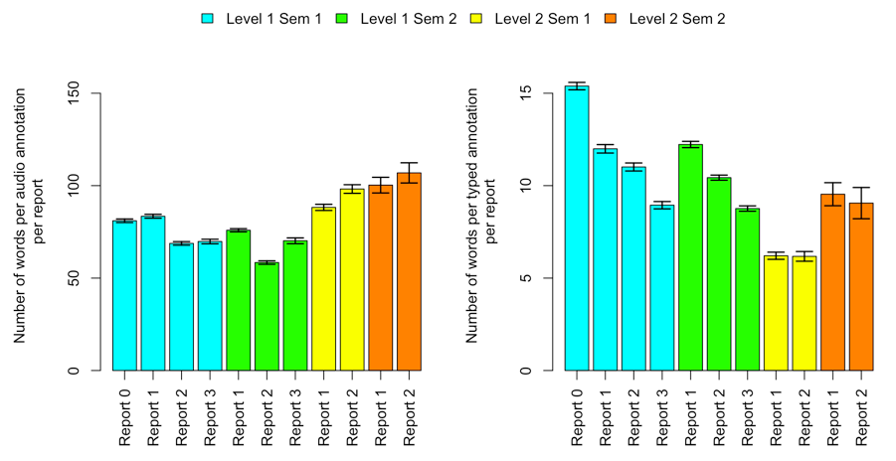
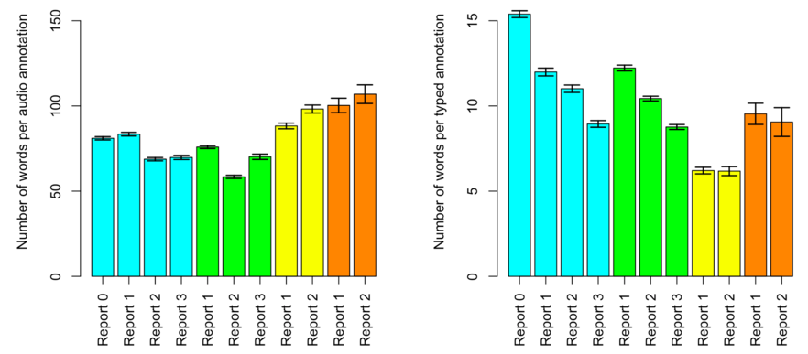
A
*
B
*
**
**
**
**
**
Notes:
Figure 3: Number of words provided in audio and typed feedback for level 1 course (Report 0: n=681, Report 1: n=1559, Report 2: n=1535, Report 3: n=1516 and for the level 2 course (Report 1: n=299, Report 2: n=295). Shown is the A) Mean+/-SEM number of words in audio annotations in reports across two semesters and levels; B) Mean+/-SEM number of words in typed annotations in reports across two semesters and two levels. * indicates a significant difference in the length of annotations between first and second year reports (p<0.05); ** indicates a significant difference in the length of annotations between reports (p<0.001). NB: The y-axis scale for A is 10x the y-axis scale for B.

Slide 4
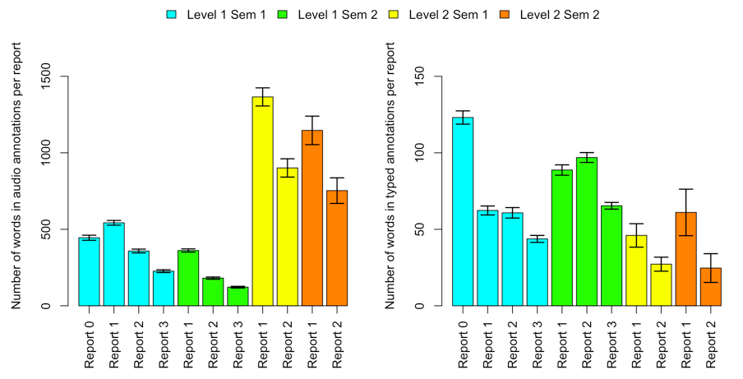
A
*
B
*
Notes:
Figure 4: Total amount of feedback provided in audio and typed feedback for level 1 course (Report 0: n=681, Report 1: n=1559, Report 2: n=1535, Report 3: n=1516 and for the level 2 course (Report 1: n=299, Report 2: n=295). Shown is the A) Mean+/-SEM number of words in audio annotations in reports across two semesters and levels; B) Mean+/-SEM number of words in typed annotations in reports across two semesters and two levels. * indicates a significant difference in the total amount of feedback between first and second year reports (p<0.05). NB The y-axis scale for A is 10x the y-axis scale for B.

Slide 5
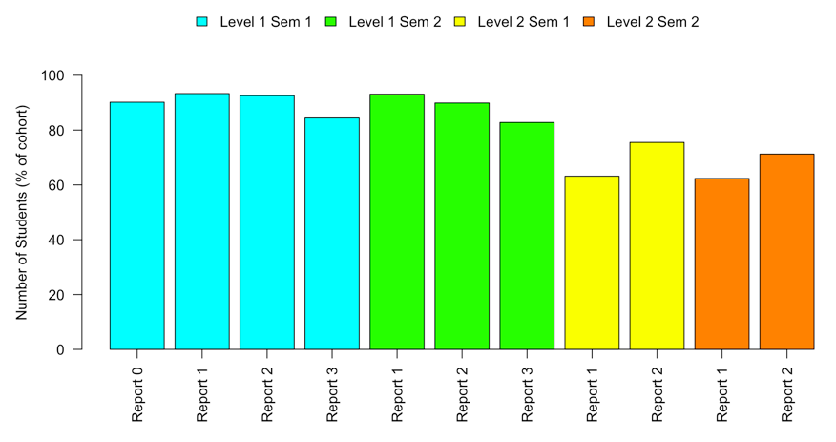
Notes:
Figure 5: The proportion of students who looked at their feedback (shown as the proportion of students who received feedback in each cohort). Number of students in each cohort: Level one semester 1: n=682; Level one semester 2: n=897; Level two semester 1: n=239; Level two semester 2: n=85.

Slide 6
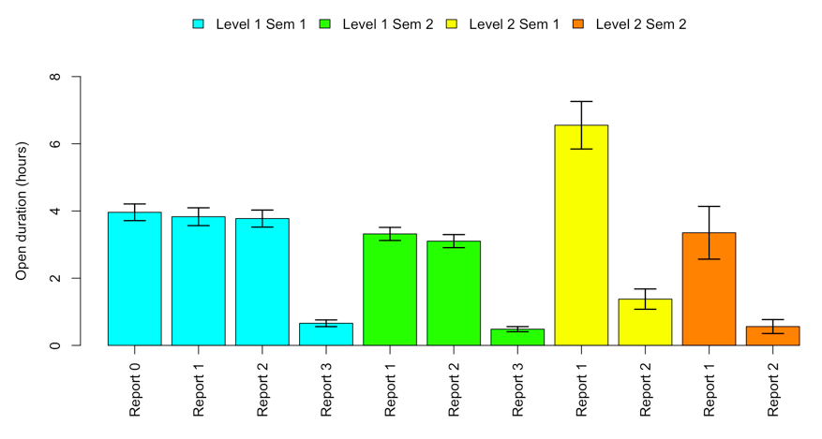
Notes:
Figure 6: The duration students had their report feedback open for the level 1 course (Report 0: n=682, Report 1: n=1571, Report 2: n=1541, Report 3: n=1521) and for the level 2 course (Report 1: n=324, Report 2: n=321). Data are expressed as the mean+/-SEM time for which each report was open, in hours.

Slide 7
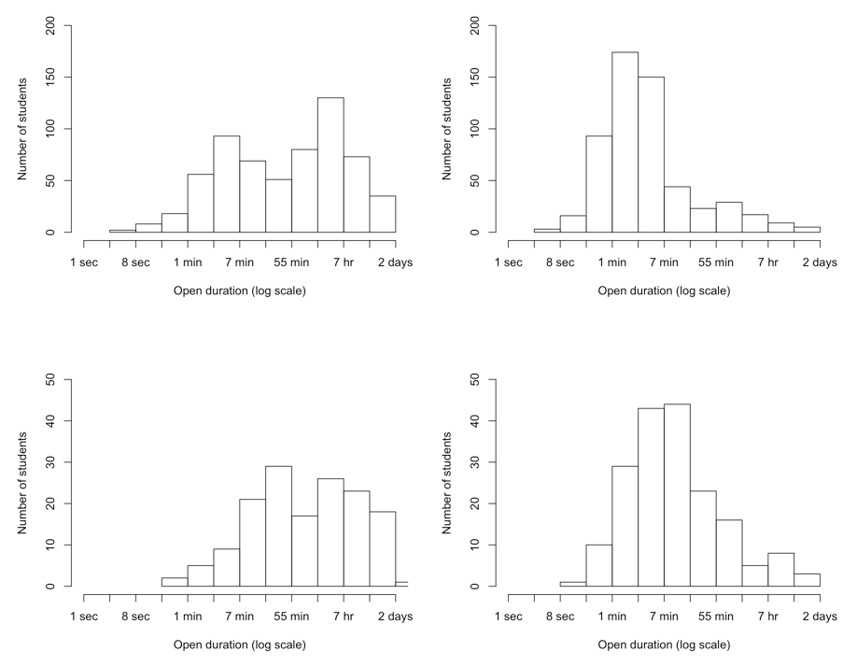
Notes:
Figure 7: The number of students who had their feedback open for various durations following the level one semester one course A) formative report (Report 0: n=682), and B) final report (Report 3: n=667), and the level two semester one course C) first report (Report 1: n=239), and D) final report (Report 2: n=241). Data are presented as a frequency histogram showing the number of student across the log transformed open duration.

Slide 8
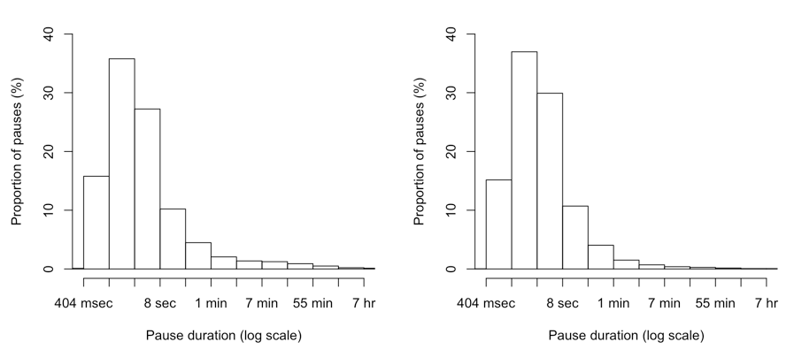
Notes:
Figure 8: Frequency histogram of the duration that students pause between clicks when interacting with feedback for the A) non-final reports (n=3686 reports) and B) final reports (n=1509 reports). Data are expressed as the proportion of pauses students took between clicks, ranging from milliseconds to hours (x scale is log transformed to improve clarity).

Slide 9
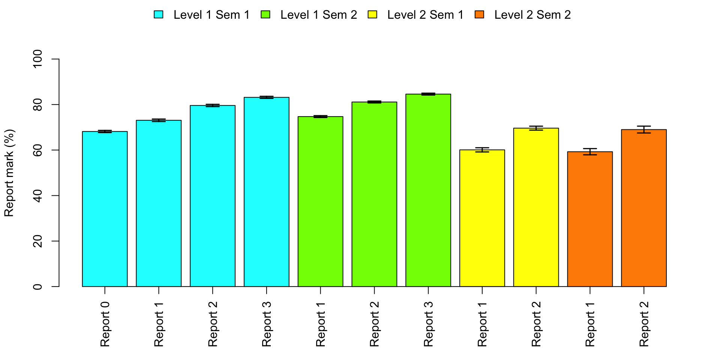
*
*
*
*
*
*
*
*
*
Notes:
Figure 9: Overall final mark for reports in the level 1 course (Report 0: n=682, Report 1: n=1571, Report 2: n=1541, Report 3: n=1521) and for the level 2 course (Report 1: n=324, Report 2: n=321). Data are expressed as the mean+/-SEM mark that students achieved for each report, as a percentage. * indicates a statistically significant difference in report mark (p<0.05).

Slide 10
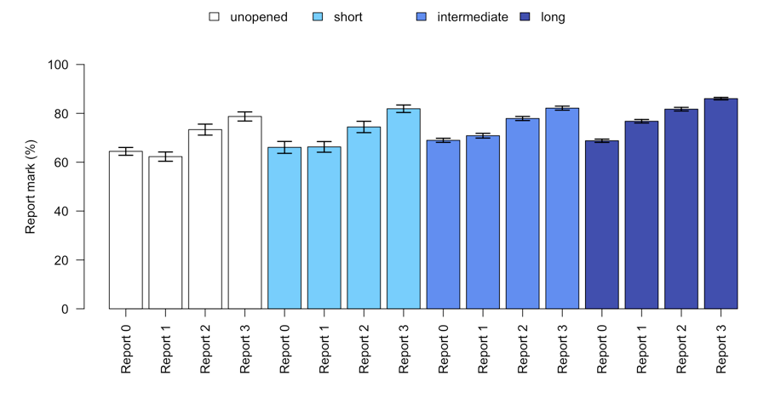
*
*
*
*
*
*
*
*
*
*
*
Notes:
Figure 10: Final marks for reports in the level 1, semester 1 course, with students categorised based on the duration for which they opened their Report 0 feedback into unopened (white bars; n = 57), and short (light blue bars; <1 minute; n = 26), medium (medium blue bars; >1 minute <1 hour; n = 264) and long (dark blue bars; >1 hour; n = 320) open durations. Data are expressed as the mean+/-SEM mark that students achieved for each report, as a percentage. * indicates a statistically significant difference in report mark (p<0.05).

Slide 11
Spares

Slide 12
Old version
A
*
B
*
**
**
**
**
**
Notes:
Figure 3: Number of words provided in audio and typed feedback for level 1 course (Report 0: n=681, Report 1: n=1559, Report 2: n=1535, Report 3: n=1516 and for the level 2 course (Report 1: n=299, Report 2: n=295). Shown is the A) Mean+/-SEM number of words in audio annotations in reports across two semesters and levels; B) Mean+/-SEM number of words in typed annotations in reports across two semesters and two levels. * indicates a significant difference in the length of annotations between first and second year reports (p<0.05); ** indicates a significant difference in the length of annotations between reports (p<0.001). NB: The y-axis scale for A is 10x the y-axis scale for B.

Slide 13
*
*
Notes:
Figure 2
markers provided significantly more audio annotations on second years’ work on average than on the first years’ reports (p<0.001; Figure 2),

Slide 14
b
b
a
a
Notes:
Fig 9

Slide 15
*
*
*
*
*
*
*
*
*
*
*
Notes:
Figure 10

